Slide 1
Merchant Categorization

Slide 2
What would be a good segmentation?
One that helps understand the activity of our customers in a way that we can customize our product to fit their needs better.
These can be –
Specialized risk management
Changing operations
Changing Costing

Slide 3
Attributes explored
1. count_txns : Total number of transactions
2. count_weekend_txns : Total number of transactions that happened on a weekend
3. count_peak_window_txns : Count of transactions that happened during the daily window of 3pm to 3am (see below pn how i came up with this)
4. avg_txn_amount : Average transaction amount
5. transaction_days : number of unique days on which the merchant transacted
6. activity_duration : time period in days from first to last transaction for the merchant
7. days_bw_transactions : average days between consecutive transactions for the merchant
8. transaction_per_day : Average transactions per day within the activity_duration
9. perc_weekend_txns : Percentage of transactions that happened on the weekend
9. perc_peak_window_txns : Percentage of transactions that happened during the daily window of 3pm to 3am

Slide 4
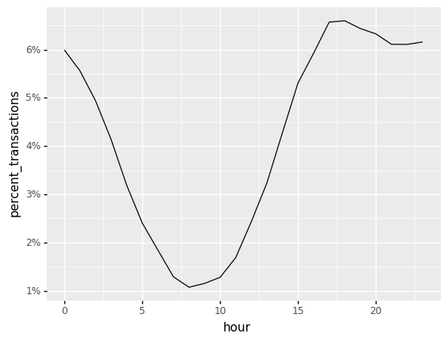
Interesting features
Almost half the merchants have 80% or more of their transactions happening in the 12-hour window from 3pm to 3am.

Slide 5
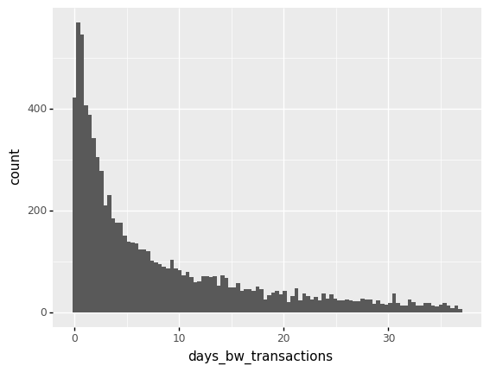
Interesting features
The average days between transactions has a log-normal type distribution where the median average days between consecutive transactions is around 5 days.

Slide 6
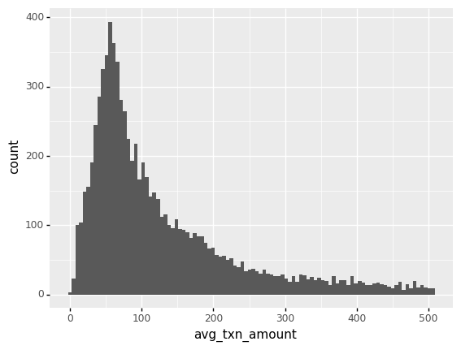
Interesting features
The average ticket size is log normally distributed i.e. around 80% of the population has an average of ~300 usd, but there is a fat tail wehre a few merchants have really high average transation sizes.

Slide 7
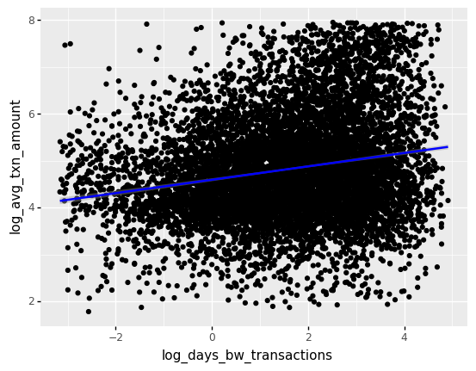
A first shot at segmentation
-Clearly there is a significant correlation of the frequency(inverse of average days bw transactions) of transactions with ticket size.
As frequency increases, merchants are likely to be lower ATS.
- the variation of ticket size is much higher amoug merchants with lower transaction frequencies(higher average days between transactions).

Slide 8
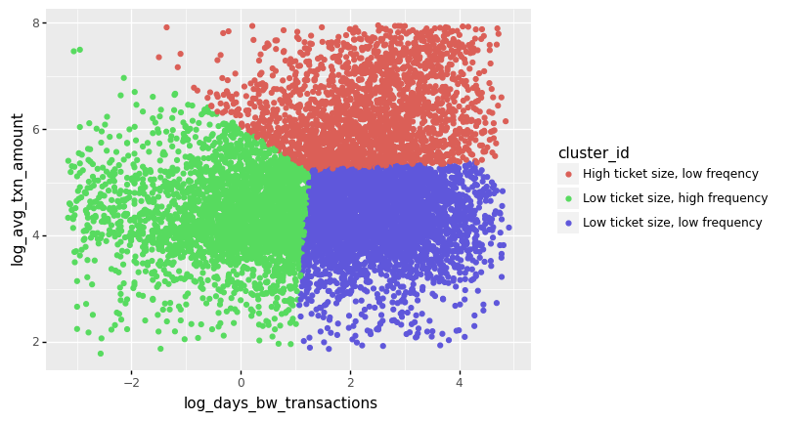
Running a segmentation algo
Visualising the clusters in log space, the clusters represent 3 distinct categories -
1. Merchants who transact frequently and have low average days between transactions.
2. Merchants who transact infrequently but have a higher average transaction size when they transact.
3. Merchants who transact infrequently and also have a lower average transaction size when they transact.

Slide 9
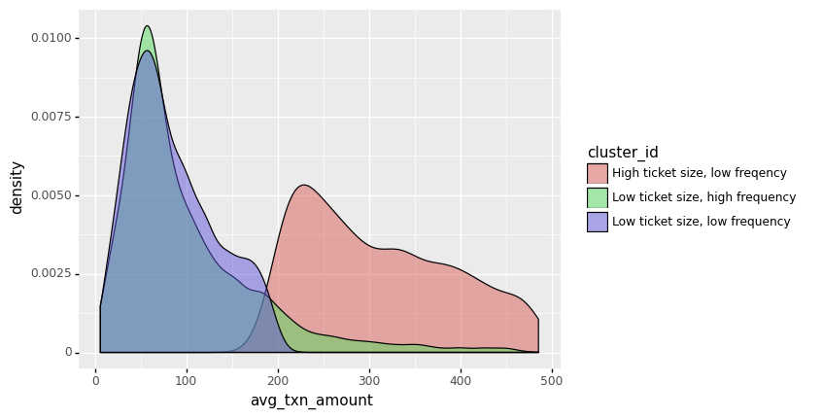
Running a segmentation algo

Slide 10
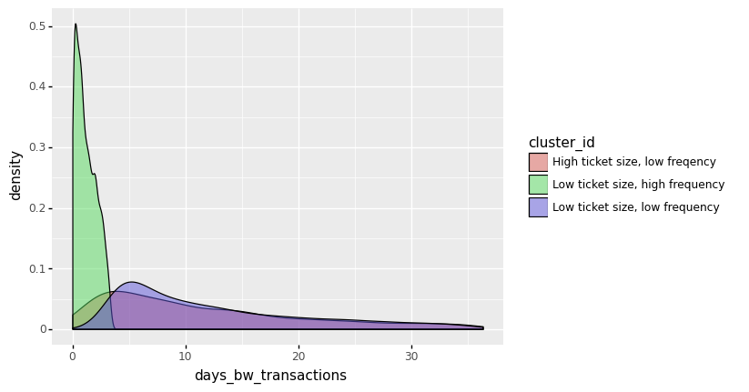
Running a segmentation algo

Slide 11
Distributions
 | days_bw_transactions |  |  |  |  |  |  | avg_txn_amount
 | count | mean | min | 25% | 50% | 75% | max | mean | min | 25% | 50% | 75% | max
cluster_id
High ticket size, low freqency | 2231.0 | 17.7 | 0.2 | 5.0 | 10.9 | 23.2 | 128.0 | 711.4 | 188.7 | 293.5 | 478.4 | 903.3 | 2837.1
Low ticket size, high frequency | 3084.0 | 1.3 | 0.0 | 0.5 | 1.1 | 2.0 | 3.5 | 105.9 | 5.9 | 51.8 | 76.0 | 131.5 | 1797.0
Low ticket size, low frequency | 3597.0 | 18.5 | 2.9 | 6.2 | 11.8 | 23.7 | 136.0 | 85.7 | 6.5 | 48.9 | 75.2 | 118.1 | 212.2

Slide 12
Use cases
The different segments need a different kind of service from stripe. For example,
merchants where the frequency of transactions are high but the ticket size is low, we could work on automating and reducing any operational costs since they would be incurred for each transaction.
We can also be more comfortable with the risk in these cases since the ticket sizes are low and any single transaction being fraudulent does not have a very high-cost relative to the revenue generated by the merchant for us.
Similarly, merchants with high average ticket sizes and do not transact frequently need stricter fraud checks.

Slide 13
Limitations
Have not explored the distributions of payment amounts and the frequency of payments, just used averages, further information can be derived from nuances in the distributions and joint distributions. Eg subscriptions etc.
Have not explored the dimension of how merchants are different in the time window in which hey operate. Almost half the merchants have 80% of more transactions in the time window between 3pm to 3am. This can be a very valuable dimension for us.

